Slide 1
Yanfeng Visteon SUPPLIER APQP PORTAL
Project Discussion / 项目讨论
Jan 3rd 2018
V3.0

Slide 2
Agenda/议程
Omnex & Yanfeng Team Introductions / 团队介绍
Customer Requirements / 客户需求
Background & Pain Point / 需求背景和痛点
Requirements Specification / 需求说明
Understanding of Customer Requirements / 需求理解
Functional Requirements / 功能性需求
OMNEX Solution / OMNEX 解决方案
Application Architecture / 应用架构
System Infrastructure / 系统部署架构
Application Feature List / 应用功能清单
Project Implementation Methodology / 项目实施方法论
Implementation & Release Plan / 实施和发布计划
Q&A / 问题与回答

Slide 3

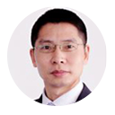


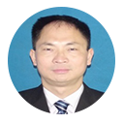


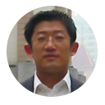




Omnex Project Org Chart / 奥曼克项目组织架构图
Chad Kymal, Arun Kumar, Dave Watkins
TOP MANAGEMENT / 最高管理层
Michael Xu | Antony John
Michael Zhu
Sharon
Evin Xiong
Global Software Development
Christin
Steven Wang
R S Sabu
Clarence Jiang
Dora Yin
Wendy Wan
Development Team will be based out of Shanghai, India & USA.
开发团队将在上海，印度和美国

Slide 4
Yanfeng Visteon Project Team
Site / 站点 | Name / 名称 | Project role / 项目角色
Songjiang | Li Zhuo | Project Lead
 | Wang Jianjun | Key User
 | Zhang Yuanhua | Key User
 | Wang Zheyu | Key User
 | Zheng Jian | Key User
 | Hong Xiaodong | Key User
YFVIC | Wu Leilei | Project CO-Lead

Slide 5
Agenda/议程
Omnex & Yanfeng Team Introductions / 团队介绍
Customer Requirements / 客户需求
Background & Pain Point / 需求背景和痛点
Requirements Specification / 需求说明
Understanding of Customer Requirements / 需求理解
Functional Requirements / 功能性需求
OMNEX Solution / OMNEX 解决方案
Application Architecture / 应用架构
System Infrastructure / 系统部署架构
Application Feature List / 应用功能清单
Project Implementation Methodology / 项目实施方法论
Implementation & Release Plan / 实施和发布计划
Q&A / 问题与回答

Slide 6
Customer Requirements / 客户需求 - Background & Pain point / 背景和痛点
YFVE is using traditional work methods for Supplier Quality Management
E-mails to track the status of APQP,PPAP,PPQP of each suppliers;
No single point data collection and storage,
need lots of time to consolidate data,
low work efficiency.
YFVE is supposed to improve their Supplier Management Efficiency and manage the risks, and then build up a efficient information management system to monitor the APQP/PPAP/PPQP process, track issues, manage Supplier Metrics.
Cooperative work required from multi-entities, then the Content management (mainly for Document management and Version control) requirement is mandatory.

Slide 7
Customer Requirements / 客户需求 - Requirements Specification / 需求说明
To build up an APQP management platform for suppliers and realize the submission, approval, monitoring, statistics and storage of the system. The main functions are listed below:
Task start up: integrate with YFVIC system to trigger the task automatically, or trigger the task manually.
Data submission: suppliers have to submit all the tasks by the pre-defined time line, and suppliers will get notifications automatically before each time line.
Approval: YFVIC SQE will audit the materials that submitted by the suppliers and decide to reject or approve the application online. The system should allow YFVIC SQE to log the reject reasons or comments, and all the historical records should be logged automatically.
Monitoring: Any tasks expired (violating need date), the system should send notification to SQE and suppliers, and also escalate the tasks to higher level managers according to the expired date pre-defined.
Statistics (report): Generate report by three dimensions (by projects, by suppliers, by SQE)
ALL BUSINESS DATA NEED TO BE STORED AT LEAST FOR 15 YEARS.
EXTERNAL INTERFACE: Realize the standard input/output functions according to YFVE’s detailed requirements.

Slide 8
Agenda/议程
Omnex & Yanfeng Team Introductions / 团队介绍
Customer Requirements / 客户需求
Background & Pain Point / 需求背景和痛点
Requirements Specification / 需求说明
Understanding of Customer Requirements / 需求理解
Functional Requirements / 功能性需求
OMNEX Solution / OMNEX 解决方案
Application Architecture / 应用架构
System Infrastructure / 系统部署架构
Application Feature List / 应用功能清单
Project Implementation Methodology / 项目实施方法论
Implementation & Release Plan / 实施和发布计划
Q&A / 问题与回答

Slide 9

Requirements Understanding - Functional Requirements – Main Process
根据外部输入
任务选择
开启/关闭或重新开启模块及具体任务
根据外部输入
任务选择
开启/关闭或重新开启模块及具体任务
upload
HIS证明
建立料号，录入基本信息，项目责任人定义
SNL
APQP
PPAP
PPQP
PPAP
PPQP
定期跟踪APQP状态
ASDE/SQE 上传PSW
ECR
分配任务
责任人接收料件任务
各项任务完成完任务关闭
yes
批量导入
5. HIS与否
(系统评估结果和附件)
项目交接
Single part
End

Slide 10
Requirements Understanding - Non-Functional Requirements
The application should be deployed on the cloud, and the following characteristics should be considered :
Usability : System should be User-friendly with reduced clicks
Availability : 99.9% availability <<<See what Alicloud says in their document>>
Scalability
Security : Talk about SSL security,
System Logging strategy
Provide a 1 liner for each

Slide 11
Agenda/议程
Omnex & Yanfeng Team Introductions / 团队介绍
Customer Requirements / 客户需求
Background & Pain Point / 需求背景和痛点
Requirements Specification / 需求说明
Understanding of Customer Requirements / 需求理解
Functional Requirements / 功能性需求
OMNEX Solution / OMNEX 解决方案
Application Architecture / 应用架构
System Infrastructure / 系统部署架构
Application Feature List / 应用功能清单
Software Prototype / 软件原型
Project Implementation Methodology / 项目实施方法论
Implementation & Release Plan / 实施和发布计划
Q&A / 问题与回答

Slide 12


YANFENG SUPPLIER APQP PORTAL / 延锋供应商APQP入口
SUPPLIER
METRICS /
供应商指标
PROJECT /
PROGRAM
MGMT
项目/程序（大项目）管理
SUPPLIER
PORTAL
供应商入口
Supplier
APQP
PORTAL
供应商
APQP入口
DOCUMENT
MGMT/
文档管理
ISSUES / RISK
MGMT
/问题/风险管理

Slide 13


Yanfeng Visteon - Supplier APQP Portal
OMNEX Solution Proposed - Application Architecture
YANFENG Internal User
Supplier Portal
Yanfeng APQP Modules
Supplier Modules
S
O
A
User Home Page, Supplier Management, APQP Program Management, Report Manager, Task Management, Issue Management, Document Management, Project Template Management, System Setup
Supplier Home Page, Supplier APQP/PPAP Program, Supplier Task, Supplier Issues, Supplier Actions, Supplier Document, Supplier News, Supplier Calendar
BPM
Business Processes
Project Plan Release
Issue Management
TR
Document Review
Supplier Document Release
SCR
Components
Business Component
Workflow/Rules Engine
Document Repository
Program Template
Gate Review Checklist
Activity Directory Integration
SOA
(System Connectivity)
PPQP
Checklist
Project Deliverable Review Checklist
Database

Slide 14
OMNEX Solution Proposed - System Architecture
PPQP
APQP
PPAP
Supplier Quality Management System
Pur
Org Management
Account Management
Content Management
SQEM
Project Management
Workflow Management
(or Task Mgt)
Template Management
SQE
Issue Management
Report Management
Others(Mail, Notification…)
SUPPLIER
data
doc
data
BPM(modifications, project kick-off…)
DMS(Hyper-link to file server)
QAD(Suppliers’ information)

Slide 15
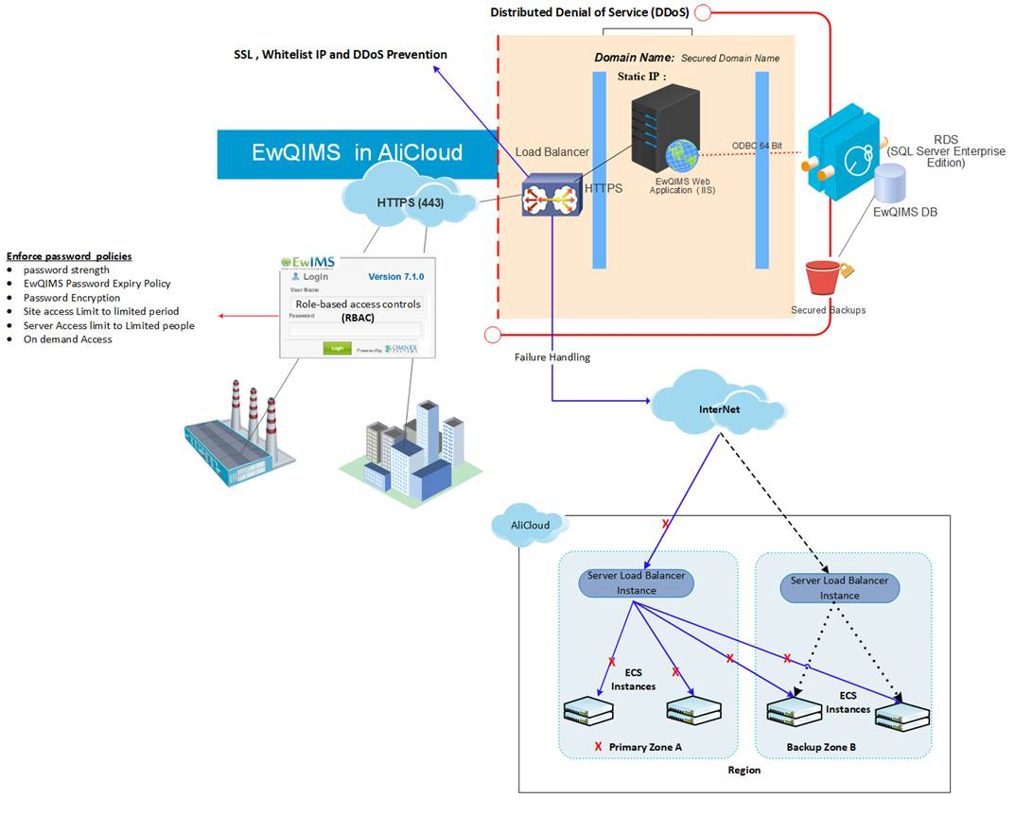
Solution Deployment on Ali Cloud
Notes:
1, need a diagram to demonstrate the whole system’s infrastructure;
2, need to avoid the single point of failure in our design;
3, the suggested hardware configuration should be provided here(according to user’s usage situation);
Total users number will be 500 or more;
According to Li Zhuo’s estimation, the concurrent users at peak time will be 100-200,

Slide 16
OMNEX Solution Proposed - System Feature List
@Sabu, we can use the one you presented in the meeting
We need to provide the feature list here and map to the user’s requirements as well.

Slide 17

Software Prototypes / 软件原型

Slide 18
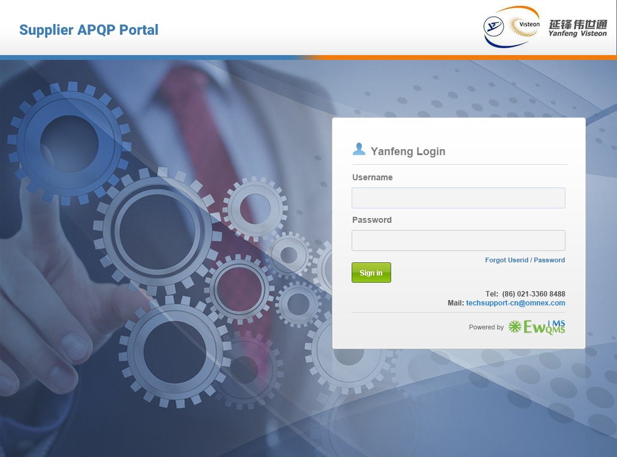
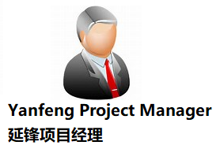

Slide 19
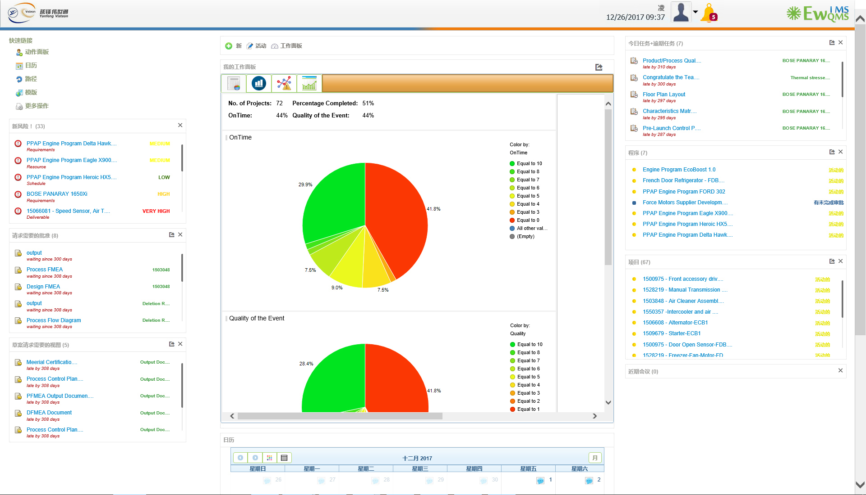

Slide 20
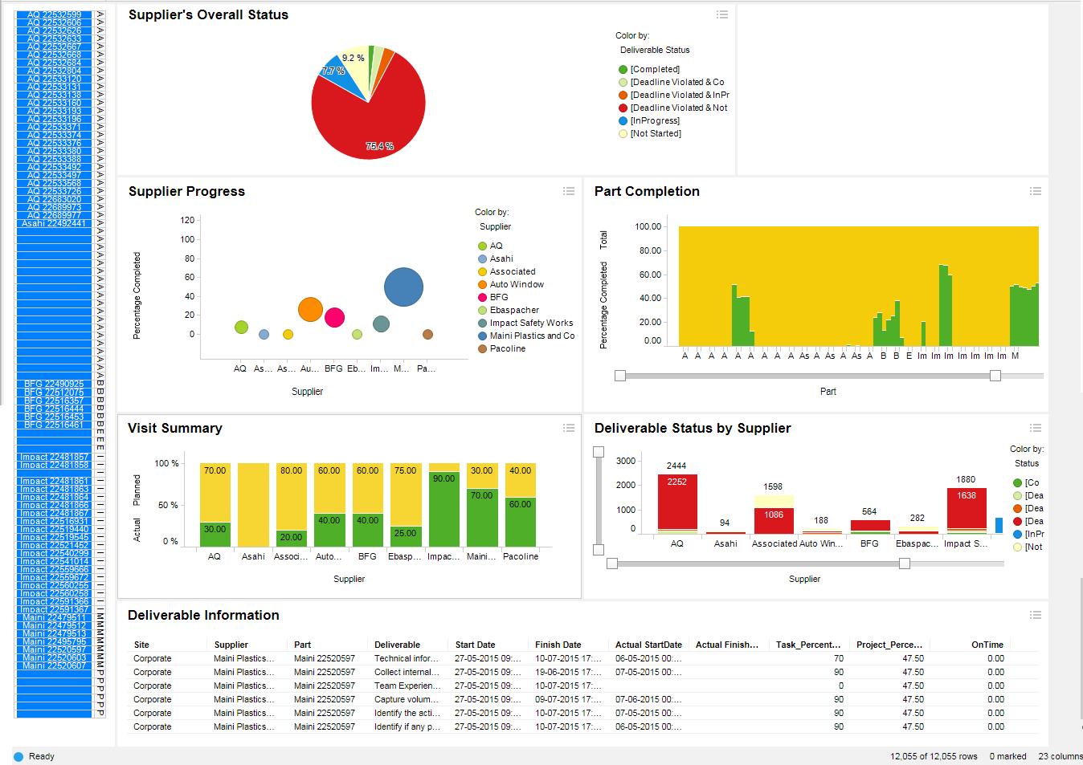

Supplier Dashboard / 供应商管理汇总表
v

Slide 21
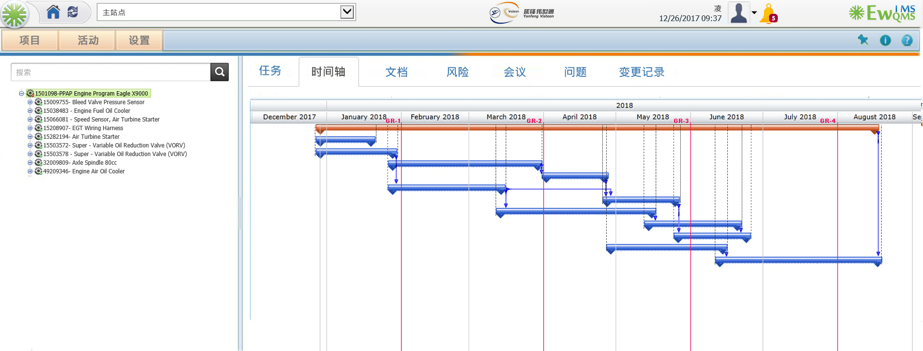

Slide 22
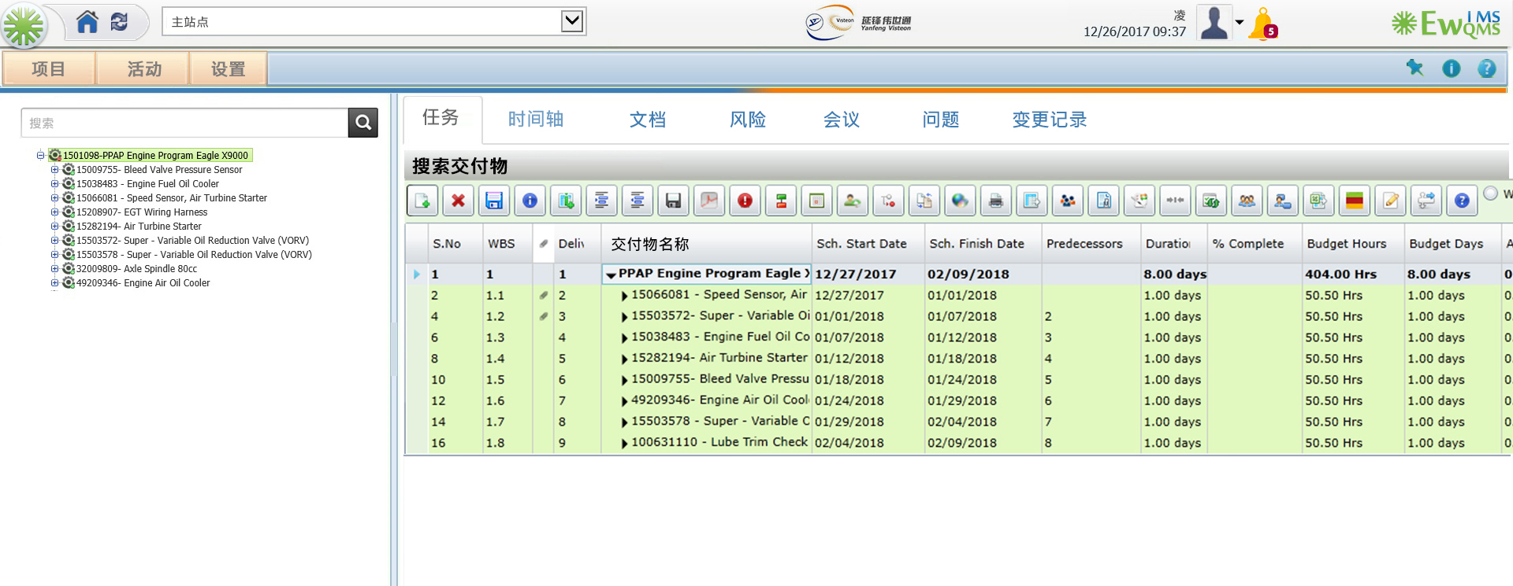

Slide 23
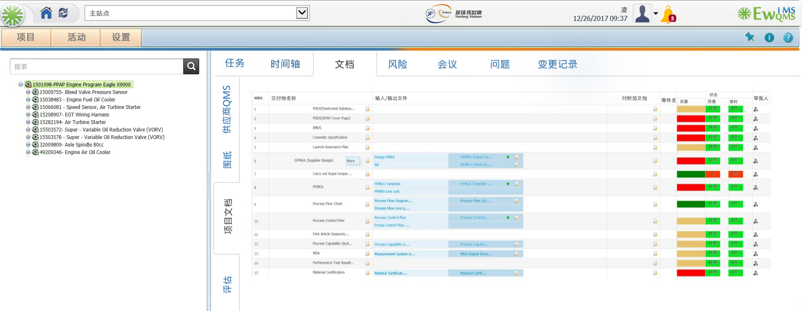

Slide 24
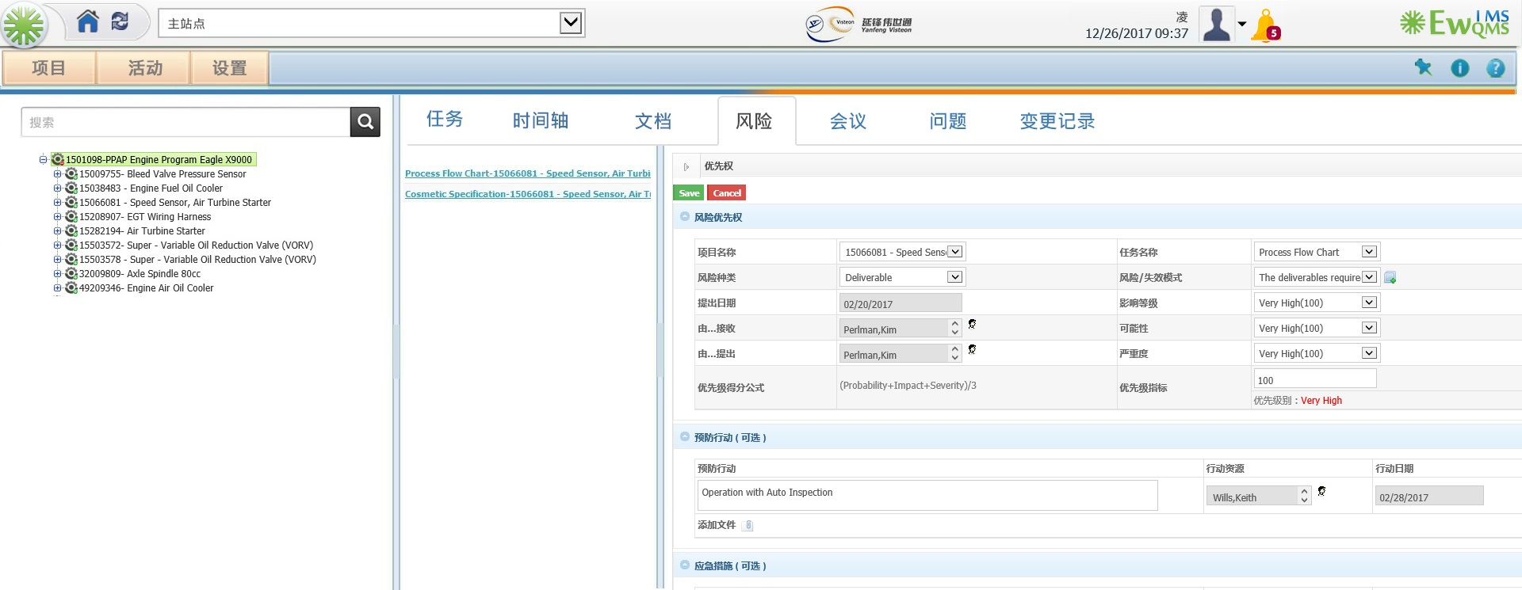

Slide 25
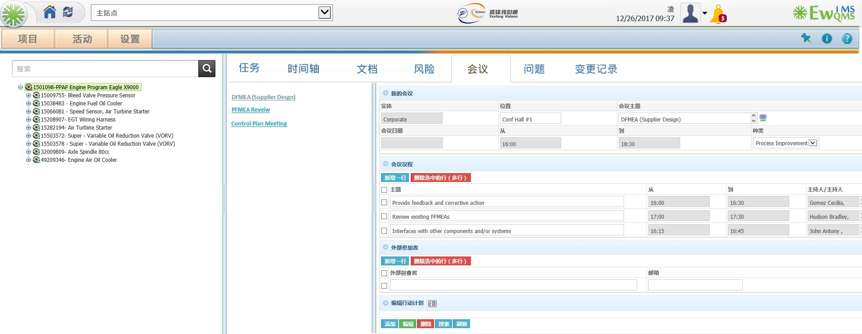

Slide 26
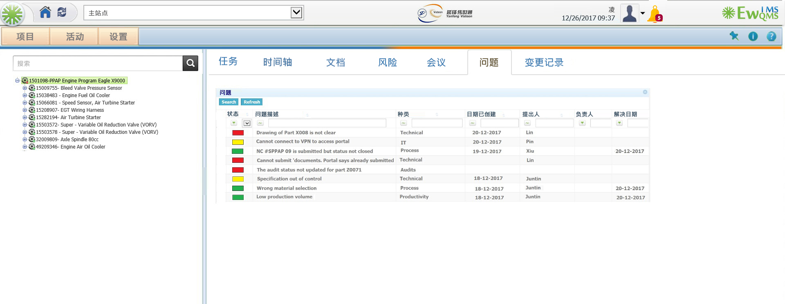

Slide 27
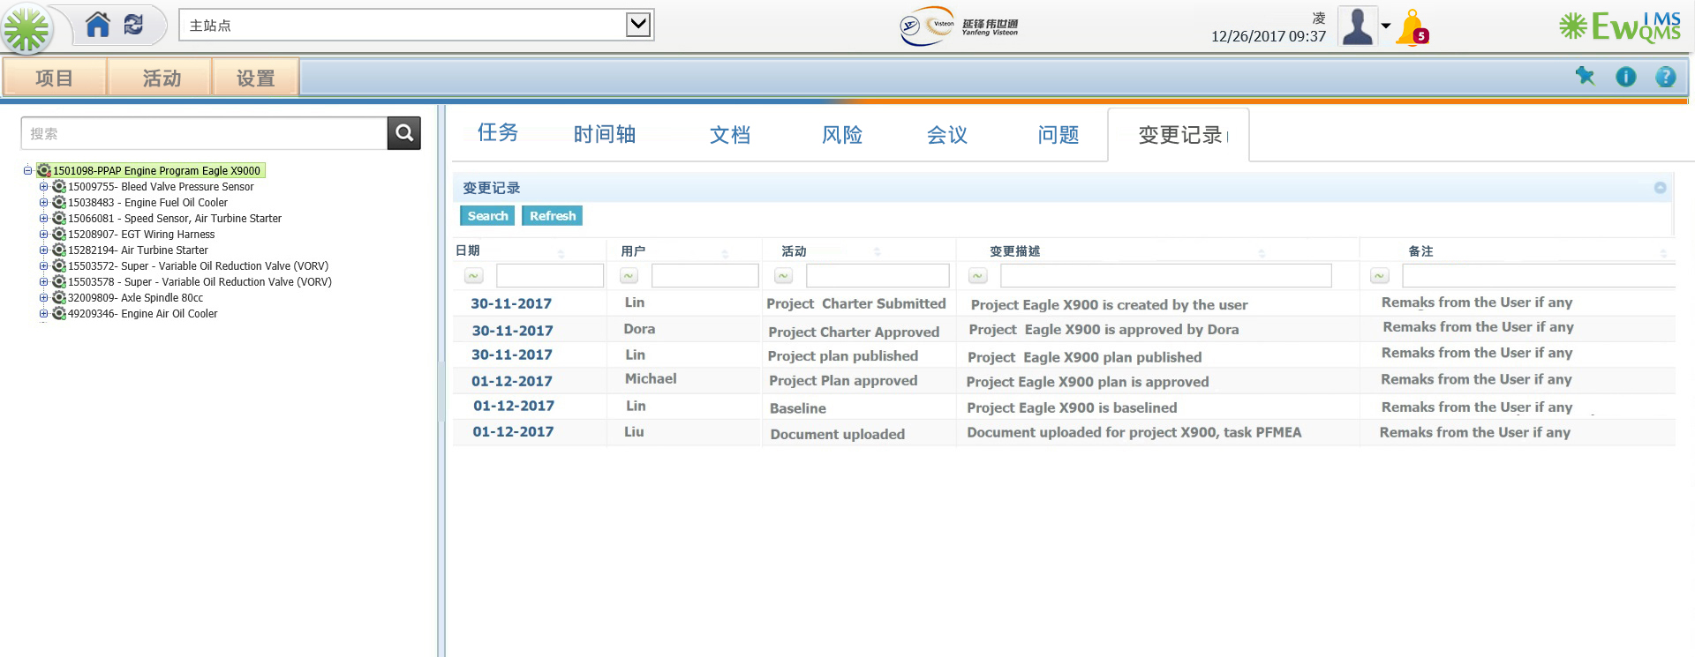

Slide 28
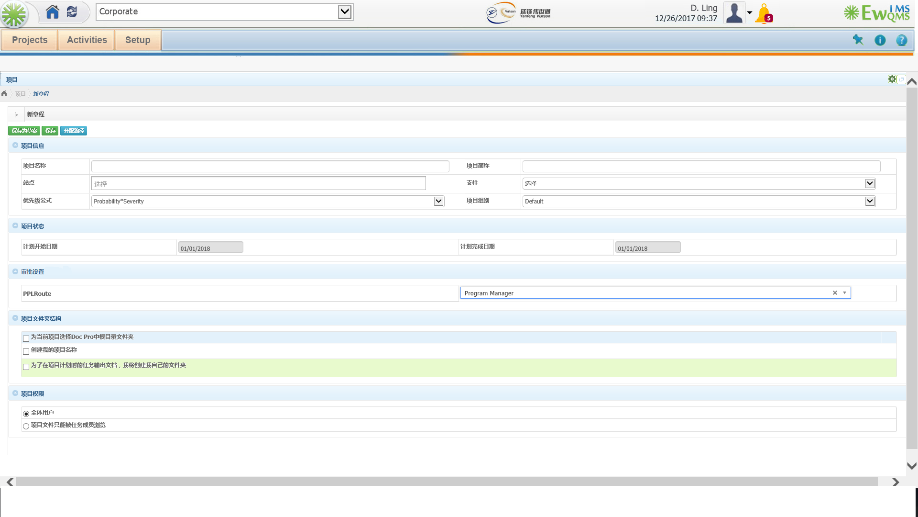
Project Charter/ 项目初始化

Slide 29
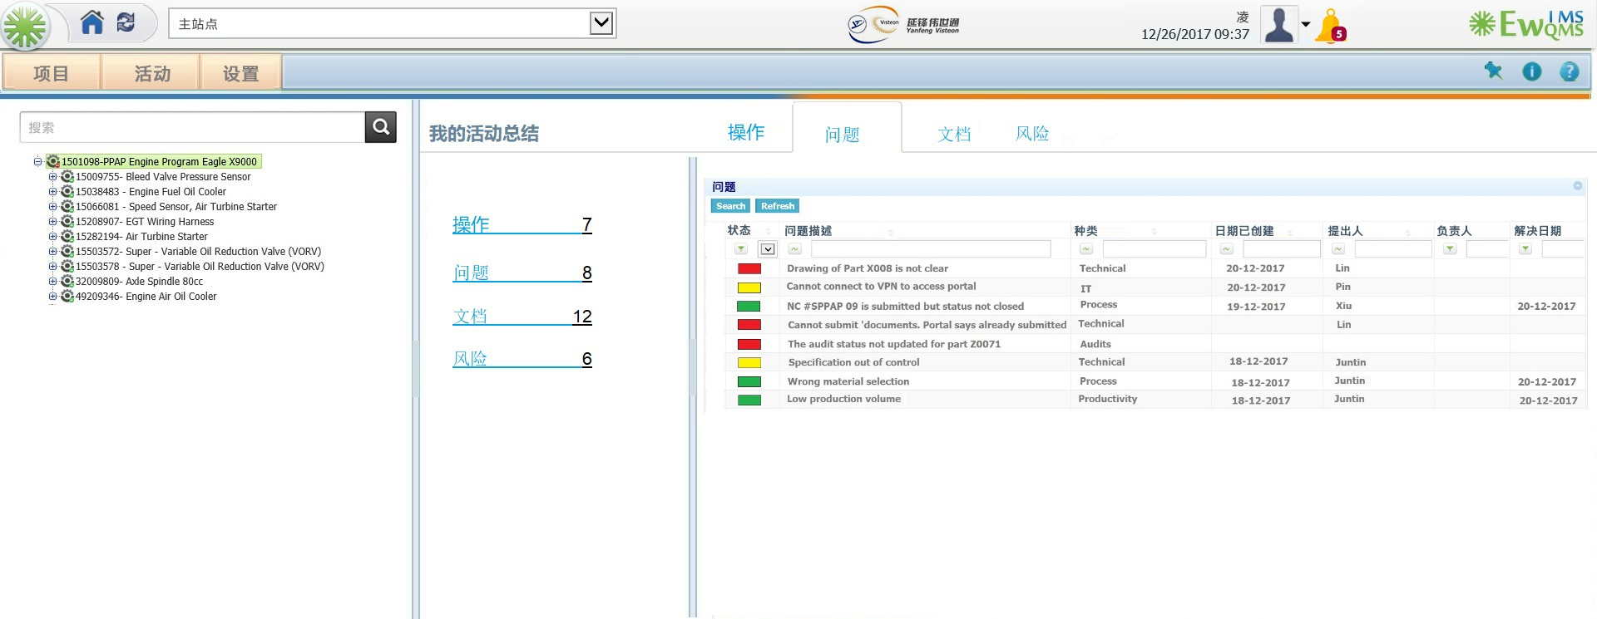
My Activities/我的任务列表

Slide 30
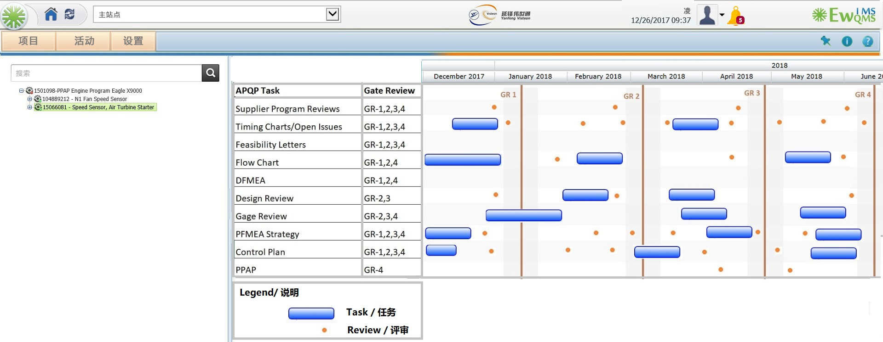

Slide 31
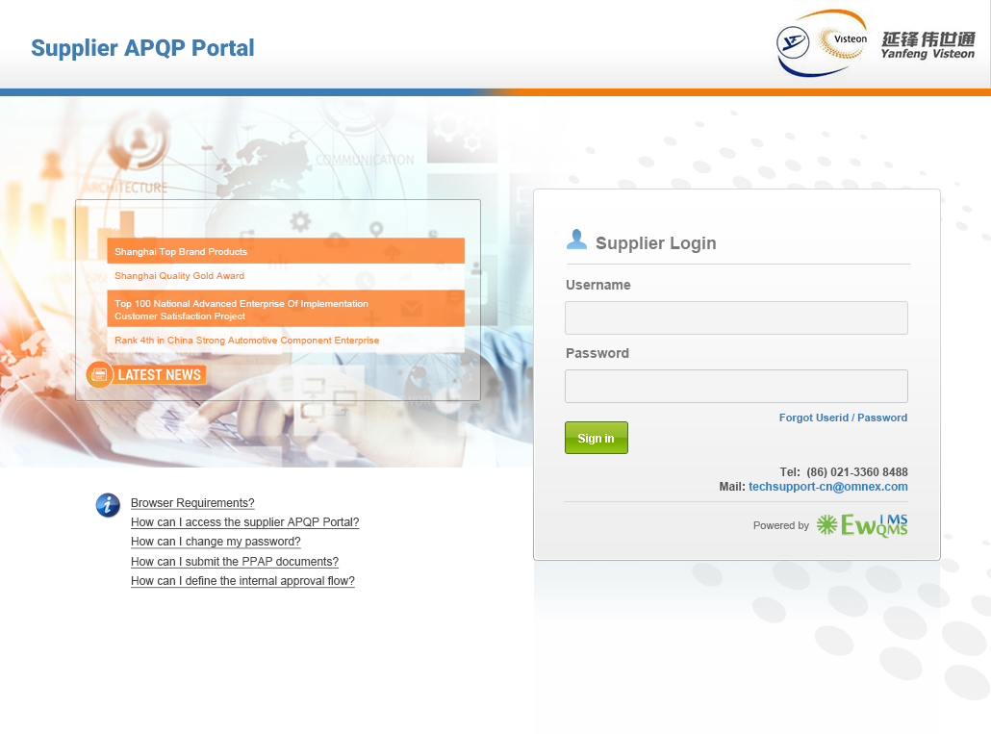


Slide 32
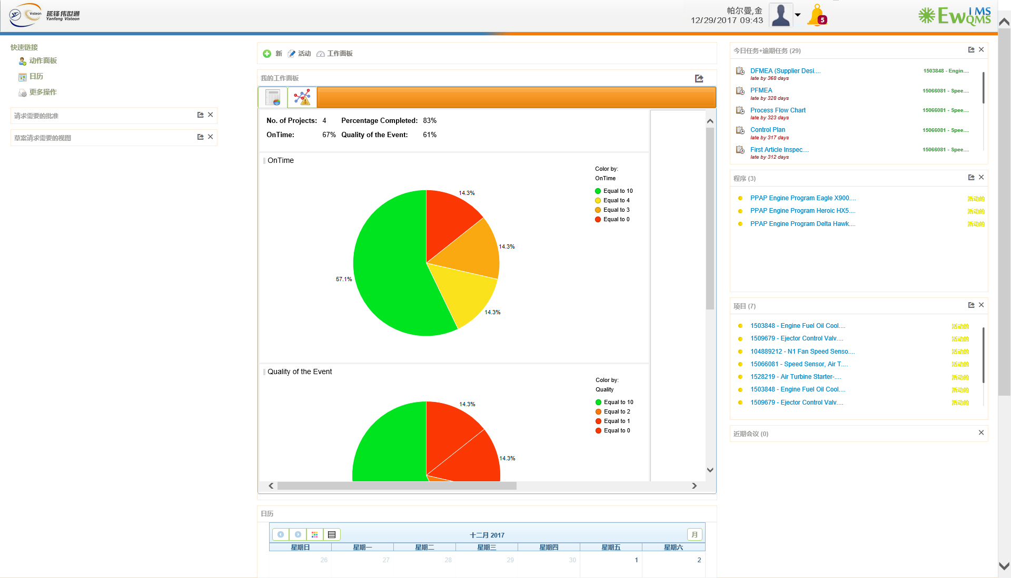

Slide 33
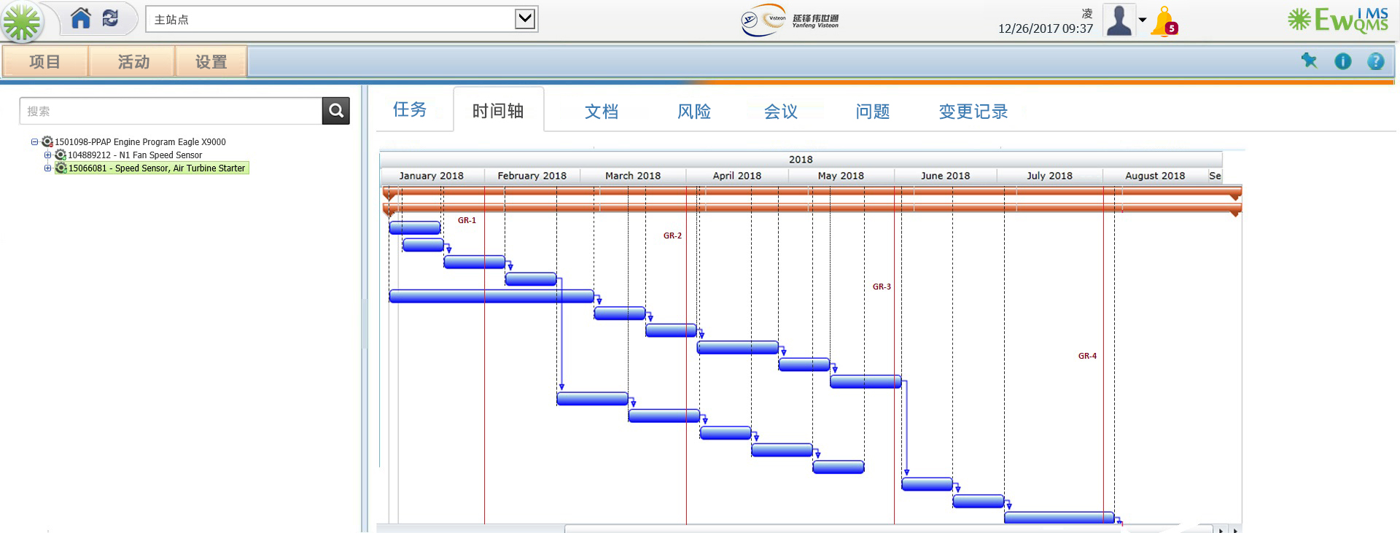

Slide 34
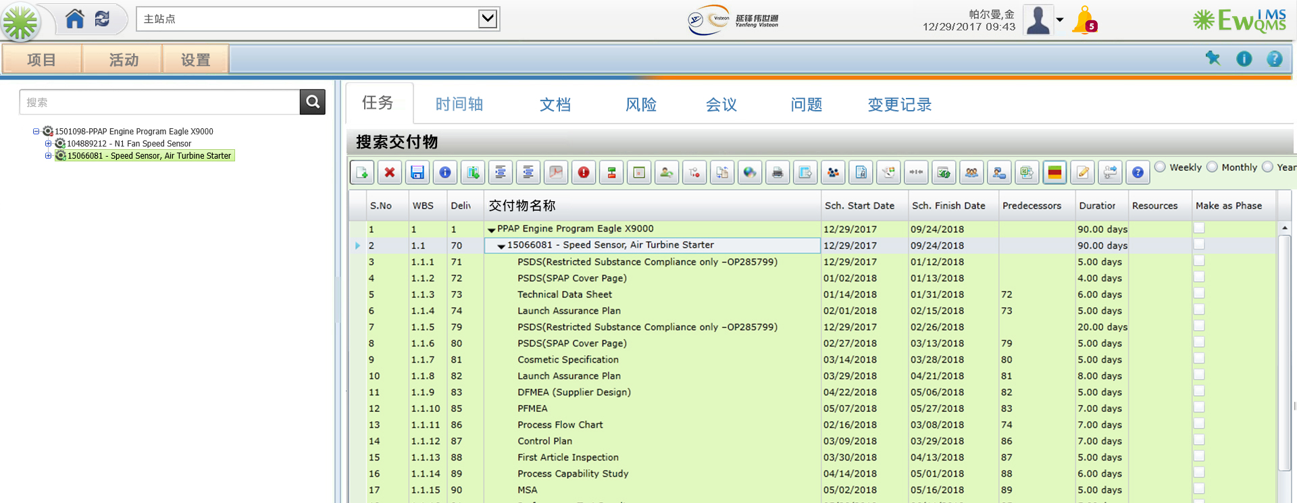

Slide 35
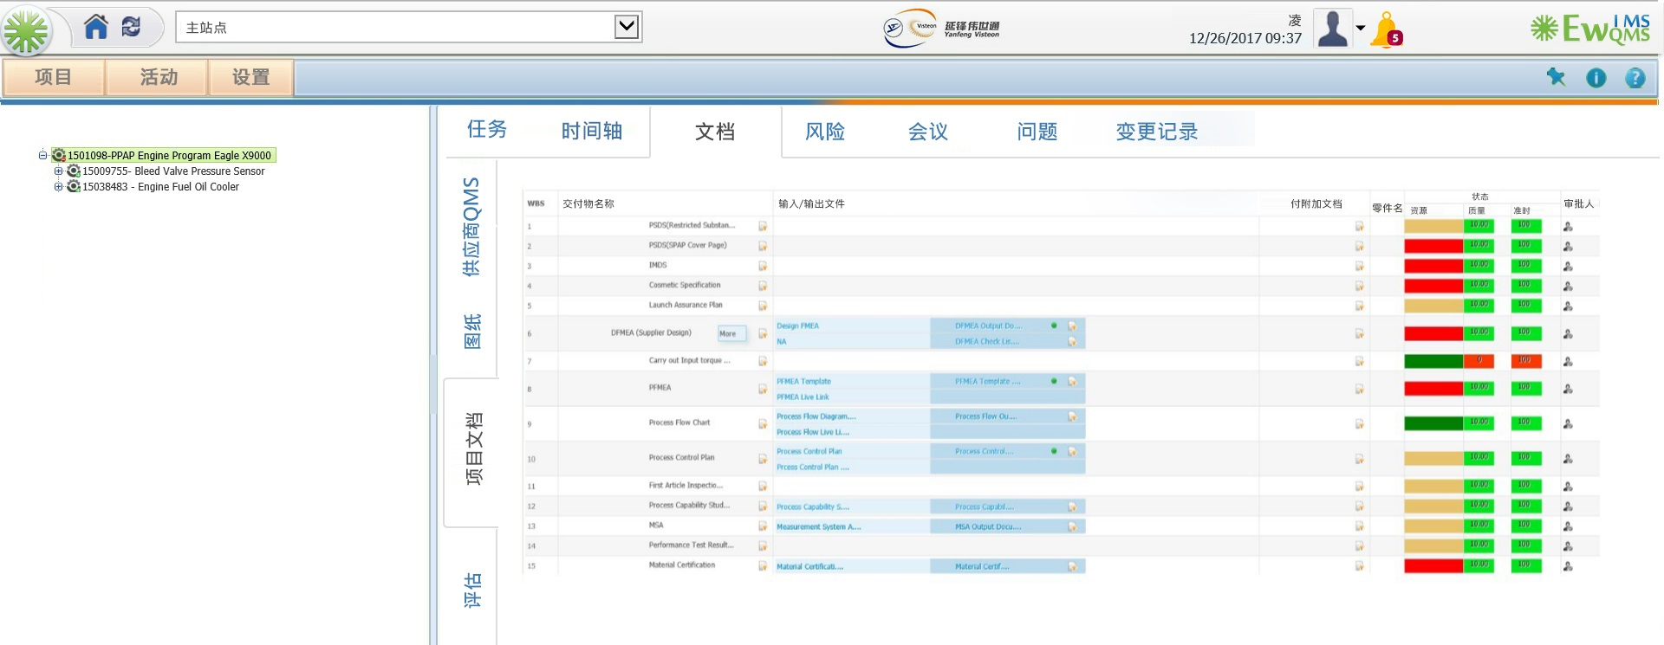

Slide 36
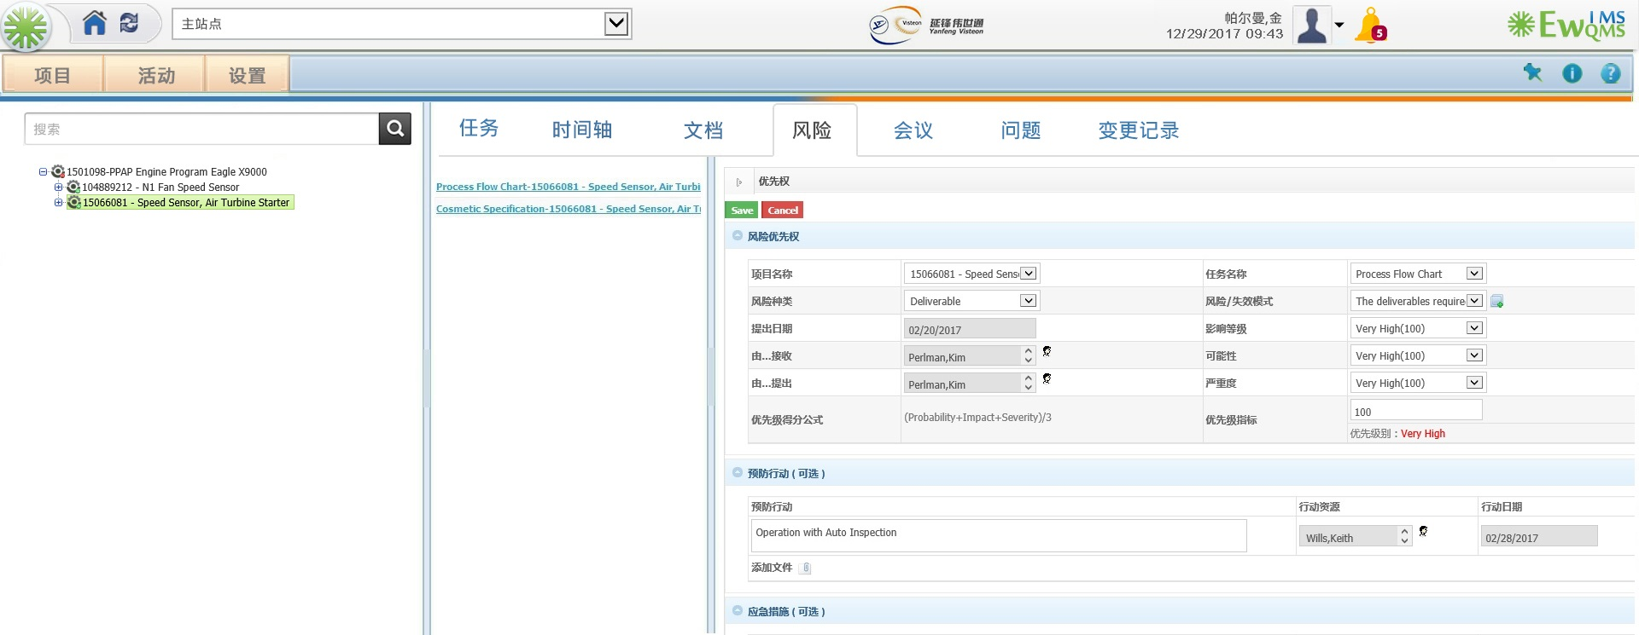

Slide 37
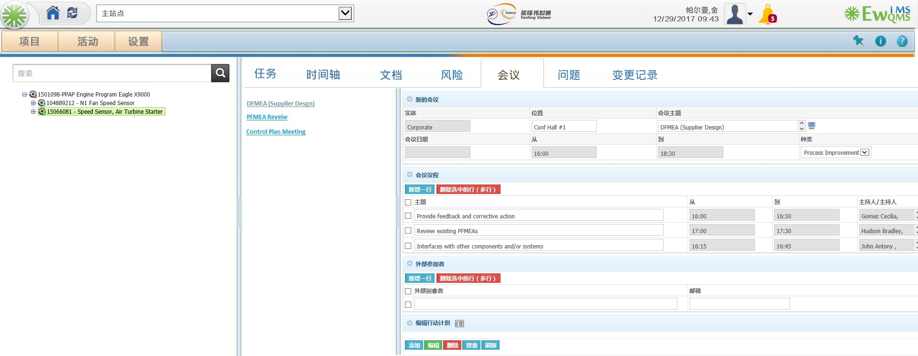

Slide 38
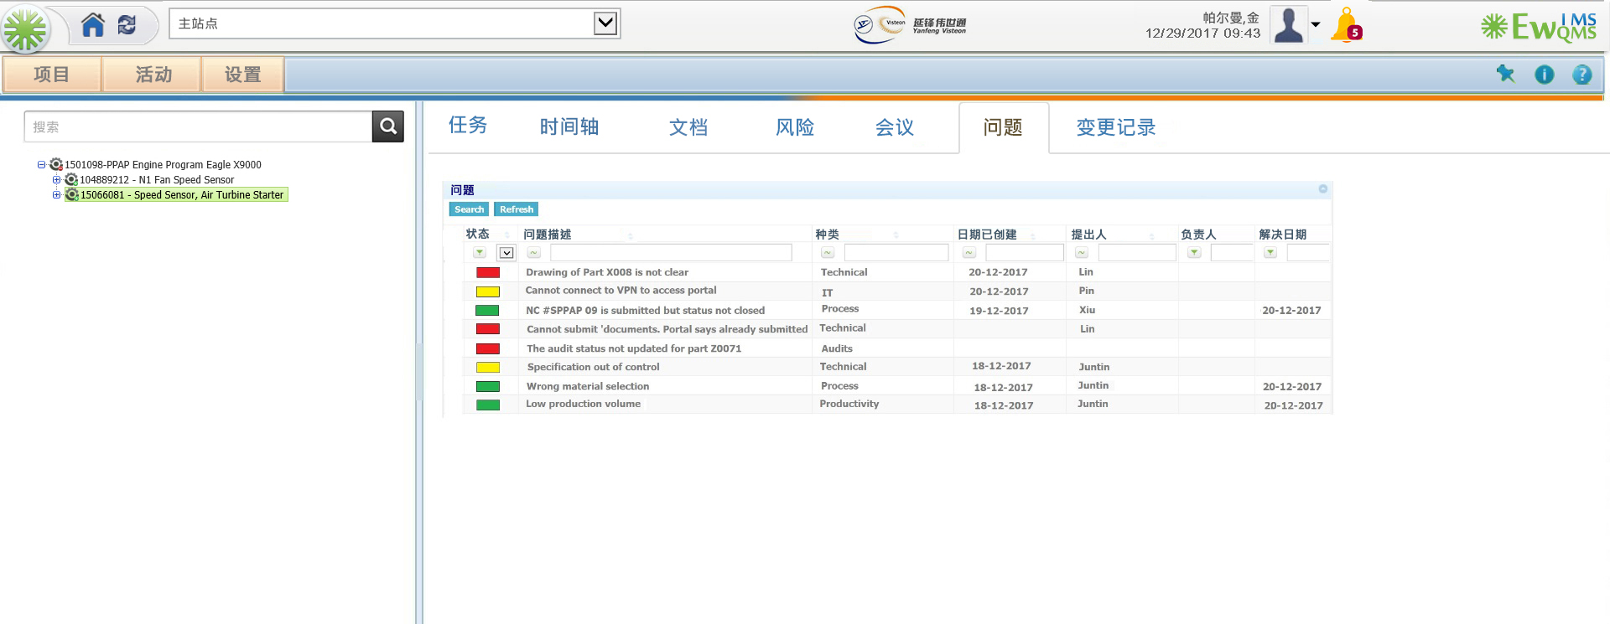

Slide 39
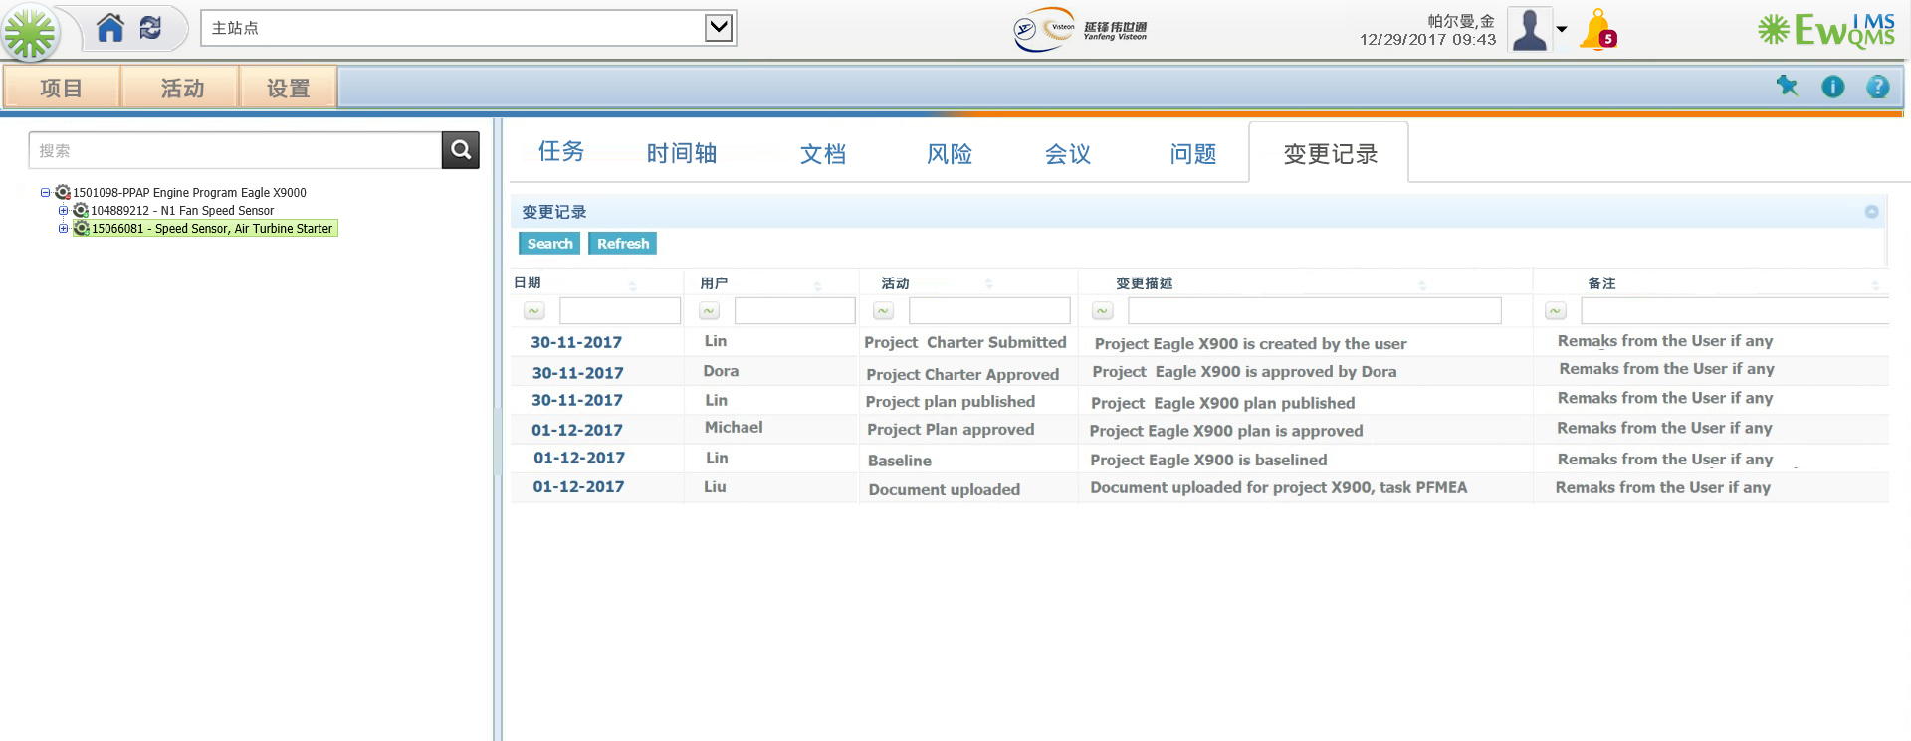

Slide 40

Project Implementation & Release

Slide 41
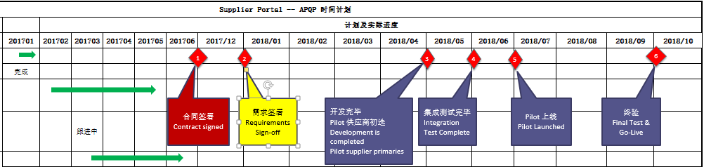
Yanfeng Supplier APQP Portal - Current Status of the Project 延锋供应商APQP入口-当前项目状态
Sabu
Update this slide for --- Don’t put actual months but say Month 1 , 2 ,3 , 4
Basically from the time they sign off on the Requirements we need 4 months to do the Pilot and then 1 month to do integration etc.

Slide 42
Key Milestones / 关键里程碑
Sabu
Update this slide for --- Don’t put actual months but say Month 1 , 2 ,3 , 4
Basically from the time they sign off on the Requirements we need 4 months to do the Pilot and then 1 month to do integration etc.

Slide 43
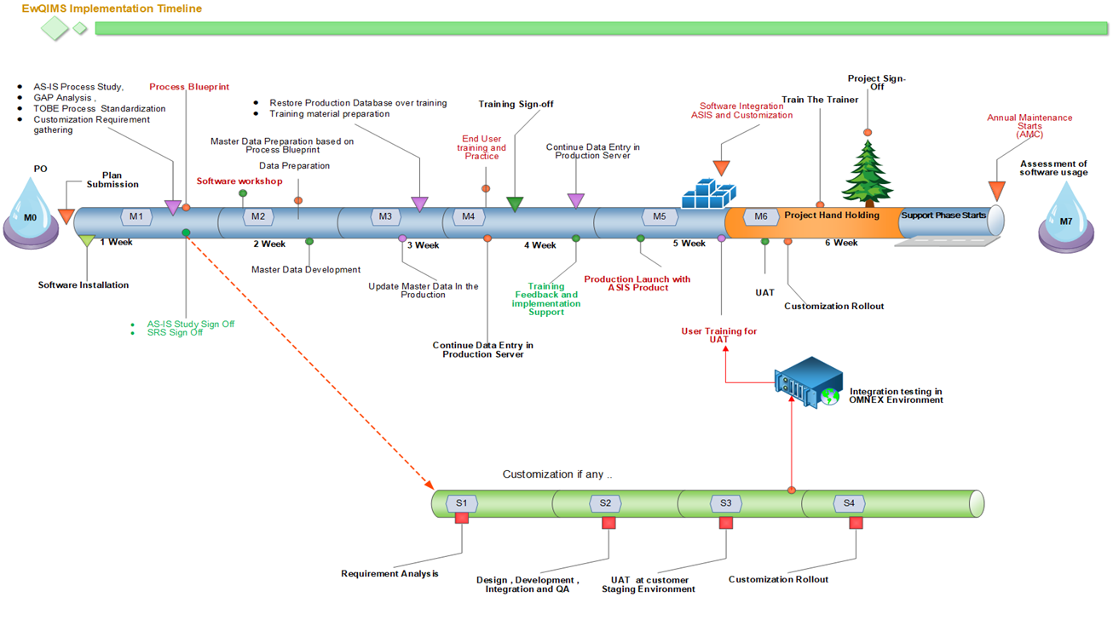
Illustrative sample
Sabu
Sabu: Treat this like a Custom project – you wont has Gap analysis etc because all that’s done already in the Project initial phase…
M2, M3, M4, M5. I think the Total Duration is 1 Month for m2 to m5
Management Report
Stakeholder report
Project signoff
Project status
UAT @ OMNEX
Software integration

Slide 44
Sabu
EWQIMS Implementation Plan and Framework
Milestone
1
Milestone
2
Milestone
3
Milestone
4
Milestone
5
Milestone
6
Milestone
Key Deliverables
Installation kit delivery
Team formation
implementation
workshop
Data collection ,
Preparation ,
Loading
End user
training
Production
Launch & Go Live
Train the Trainer
Signoff Criteria
-Deep dive As-Is requirements:
- Draft Implementation Report draft (AS-IS Process, Gap & To-be)
- Management Sign off
- Data collection sheets
-Explain to CFT the data sheet & data collection process
- Review Quality of data
- Approve & sign off
Data collection ,
Preparation ,
Loading
-Identify CFT members for each sub-module
-prepare sub-module case study for training
-Provide training for Admin, End users,
-Sign off for Go Live
-Support to set up Production data in production site
-Guide and certify one person for set up
-Handover the database, Sign off
-Train and support internal TTT
-Certify TTT candidates
-Enable TTT candidate to be internal mentors/SME
Edit the time line required
Customization
Key Activity
- Provide necessary infrastructure for installing Omnex QHSE
Facilitate study & CFT
Management Sign off
Core team formation
Workshop for CFT
Training facilities
Collect data as required
- CFT availability for Data collection
- Work with Omnex SME on data quality and sign off
- CFT availability for training
-Training facilities with lab environment
- 15 pax/training
-Perform data entry
- Availability of Admin
- User acceptance test
- Sign off & Go Live Management event
--Identify TTT candidates
-Training facilities
-TTT availability
-Complete case study write up
TEAM
- Omnex QHSE installed
- Functional Production & Training instances
- Detailed Implementation plan
- Deep Dive report
- Data prep templates for CFT
- Signed off data sheets for implementation
-Implementation report
Soft copy of user guides
-Verify and Asses production launch
-Certificate of Launch
-End user certification
- Onsite Internal TTT qualified
- Case study write up
Time line
1 Week
2 Week
3 Week
4 Week
5 Week
6 Week

Slide 45

Global Delivery Model / 全球交付模式
Global Software Development Centre – USA, China and India

Slide 46

Thank you / 谢谢

